Slide 1
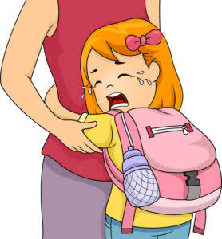
SEPARATION ANXIETY DISORDER

Slide 2

DEFINITION
Separation Anxiety Disorder is defined as an excessive worry and fear of being apart from family members or individuals.

Slide 3

What is the difference between Separation Anxiety and Separation Anxiety Disorder ?

Slide 4
DSM - 5 CRITERIA
Separation Anxiety Disorder DSM- 5 309.21 (F93.0)
DSM – 5 CATEGORY : Obsessive – Compulsive and Related Disorders

Slide 5

STAGES
Detachment phase
Despair phase
Protest phase

Slide 6

CAUSES AND RISK FACTORS
SAD is more likely to occur in children with:
Biological Factors
Family Factors
Environmental Factors

Slide 7
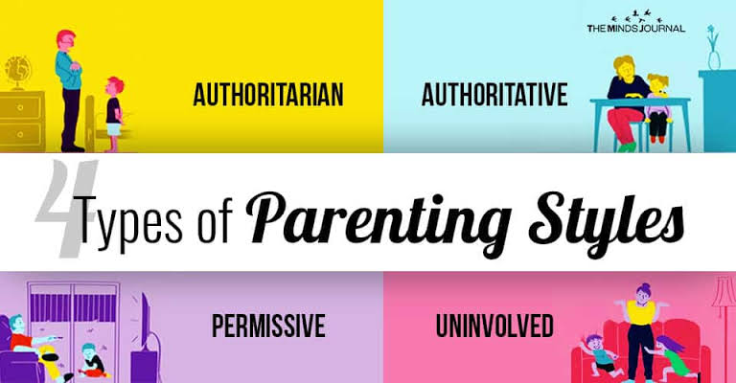

Slide 8

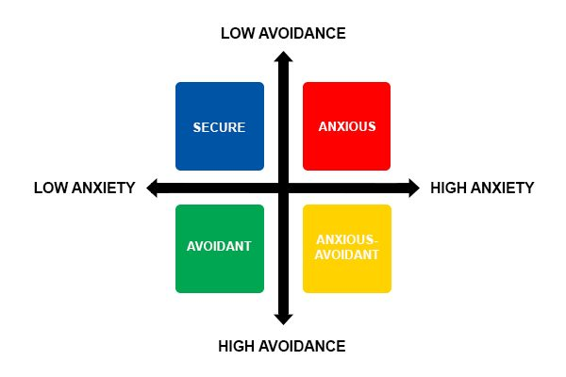
4 TYPES OF ATTACHMENT STYLES

Slide 9

Clinging to parents
Extreme and severe crying
Refusal to do things
Physical illness
Violent, emotional temper tantrums
Refusal to go to school
Poor school performance
Failure to interact
Refusing to sleep alone
Nightmares

Slide 10
EFFECTS OF SEPARATION ANXIETY DISORDER
Emotional and social development is both seriously affected by SAD.
SAD can also affect family life. Some of these problems may include:
Negative behaviour
Frustration
Jealousy

Slide 11
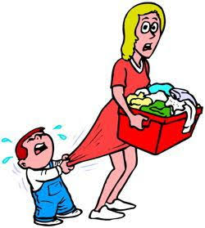
Who all can get Separation Anxiety Disorder?

Slide 12

Physical Examination
Psychological Evaluation

Slide 13

PREVALENCE
Common among
Babies (0-2 yrs)
Toddlers (3-5 yrs)
Children (6-13 yrs)
Rare among
Teenagers (14-18 yrs)
Occurs in about 4-10% of children and is more common in girls than boys

Slide 14

Medications
Psychotherapy
School intervention

Slide 15

COMORBIDITY
Depression
Personality disorders
Obsessive-compulsive disorder
Other anxiety disorders

Slide 16
REFERENCES
https://www.stanfordchildrens.org/en/topic/default?id=separation-anxiety-disorder-90-P02582
https://www.mayoclinic.org/diseases-conditions/separation-anxiety-disorder/symptoms-causes/syc-20377455
https://www.healthline.com/health/anxiety/separation-anxiety#effects-on-family-life
https://www.webmd.com/parenting/separation-anxiety#1
https://www.webmd.com/parenting/separation-anxiety#2
https://www.webmd.com/parenting/separation-anxiety#3
https://www.healthline.com/health/separation-anxiety-in-adults#adults-vs-children
https://www.healthline.com/health/anxiety/separation-anxiety#treatment

Slide 17
https://www.medicalnewstoday.com/articles/322070#risk-factors
https://www.childrenshospital.org/conditions-and-treatments/conditions/s/separation-anxiety-disorder/symptoms-and-causes
https://www.helpguide.org/articles/anxiety/separation-anxiety-and-separation-anxiety-disorder.htm
https://childmind.org/guide/separation-anxiety-disorder/
https://www.aspca.org/pet-care/dog-care/common-dog-behavior-issues/separation-anxiety
http://www.vetstreet.com/our-pet-experts/parrots-8-things-to-know-before-you-get-one
https://www.medicalnewstoday.com/articles/322070#takeaway
https://www.ncbi.nlm.nih.gov/books/NBK560793/

