Slide 1





The Power of Self-Love
Self-love is the foundation for a fulfilling and joyful life. It's about accepting and embracing yourself, flaws and all, and treating yourself with kindness, compassion, and respect.
by Kussum Tiwari

Slide 2



The Importance of Self-Love
1
Boosts Confidence
2
Improves Relationships
When you love yourself, you believe in your abilities and are more willing to take on challenges.
Self-love helps you set healthy boundaries and communicate your needs effectively.
3
Enhances Well-being
Self-love promotes self-care, mental and physical health, and overall life satisfaction.

Slide 3
Recognizing Your Worth
Embrace Your Uniqueness
Identify Your Strengths
Silence the Inner Critic
Take time to reflect on your talents, skills, and positive attributes. Acknowledge and appreciate them.
Challenge negative self-talk and replace it with compassionate, uplifting thoughts about yourself.
Celebrate the things that make you different and special. Your unique qualities are your superpower.

Slide 4


Practicing Self-Care
Mindfulness
Healthy Habits
Engage in mindful activities like meditation or journaling to cultivate self-awareness and inner peace.
Nourish your body with nutritious foods, exercise, and adequate rest to support your overall well-being.
Relaxation
Treat Yourself
Find activities that help you unwind and recharge, whether it's a warm bath, a nature walk, or reading a book.
Indulge in small acts of self-care, like buying yourself flowers or taking a solo trip, to show yourself love.

Slide 5





Overcoming Negative Self-Talk
Identify
Become aware of the negative thoughts and beliefs you have about yourself.
Challenge
Question the validity of these thoughts and reframe them in a more positive light.
Replace
Consciously replace negative self-talk with compassionate, encouraging words and affirmations.

Slide 6






Setting Healthy Boundaries
Protect
Communicate
Establish boundaries to protect your time, energy, and emotional well-being.
Clearly communicate your boundaries with others and be firm in upholding them.
Balance
Evolve
Find a healthy balance between meeting your own needs and accommodating others.
Adjust your boundaries as needed to support your personal growth and self-care.

Slide 7

Cultivating Self-Compassion
Self-Kindness
1
Treat yourself with the same compassion and understanding you would offer a dear friend.
2
Common Humanity
Recognize that everyone struggles and that you are not alone in your imperfections.
Mindfulness
3
Approach your thoughts and emotions with presence, acceptance, and non-judgment.

Slide 8
Embracing Your Unique Self
Celebrate Your Quirks
Explore Your Passions
Honor Your Authentic Self
Embrace the things that make you different and express your individuality with pride.
Devote time to the activities and hobbies that ignite your joy and fulfillment.
Live in alignment with your values, beliefs, and true desires, without apology.

Slide 9

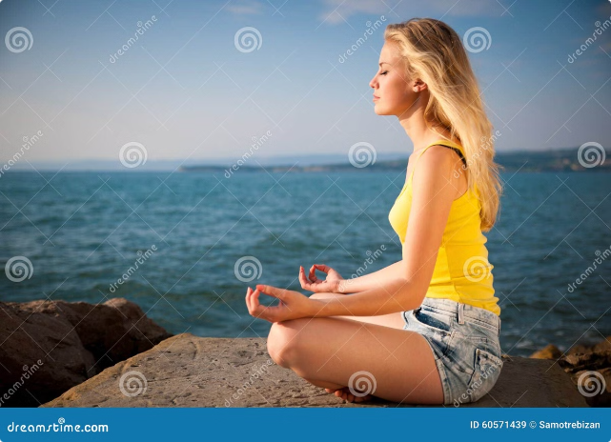
Give Importance to Yourself First
1
Self-Care is Not Selfish
2
Your Happiness Matters
Prioritizing your own needs and well-being allows you to show up as your best self for others.
Your personal growth and fulfillment should be at the forefront of your priorities.
3
You are Your Greatest Asset
Investing in yourself is the most valuable investment you can make.

Slide 10


Love Yourself More Than Anyone Else
1
Self-Acceptance
Embrace all aspects of yourself, including your flaws and imperfections.
2
Self-Appreciation
Acknowledge and celebrate your strengths, talents, and positive qualities.
3
Self-Devotion
Make yourself a priority and commit to your own growth, healing, and fulfillment.

