Slide 1


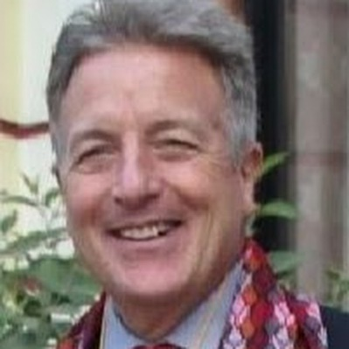

Spreading
Positive Mental Health
- Rudrani Singh Deo, Snigdha MishrA
“ The healthy minded”
(brain support brigade)

Slide 2
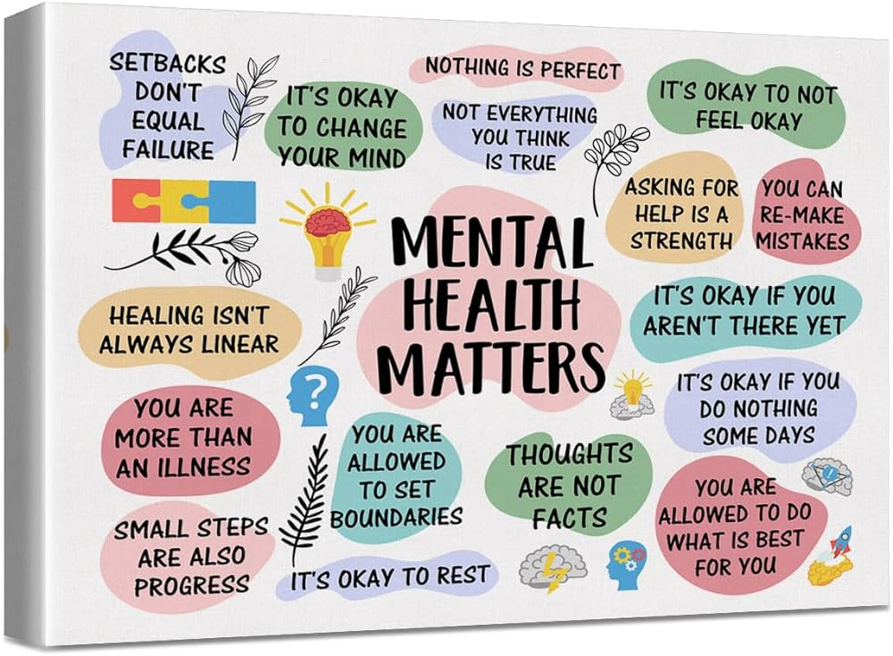
What is Positive Mental Health?
Positive mental health (PMH) is a state of emotional and psychological well-being that extends beyond the absence of mental illness. It includes functioning in psychological, social, and societal domains.

Slide 3
Some characteristics of positive mental health include:
Feeling in control of your life and personal decisions
Being able to cope with life's challenges and stresses
Functioning well mentally, such as being able to focus while at work
Being generally optimistic about life events
Feeling happy, confident, hopeful, and generally satisfied with life
Feeling connected to other people and to be making a contribution to society
Having a sense of meaning or purpose and a feeling of being at peace

Slide 4
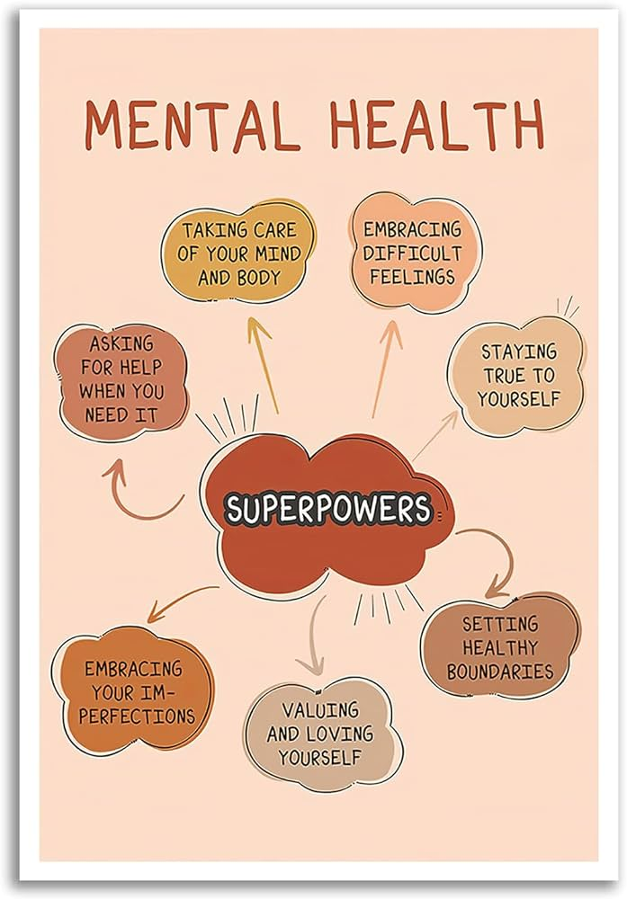
Some habits that can help with positive mental health include:
Getting regular exercise
Eating healthy, regular meals and staying hydrated
Making sleep a priority
Trying a relaxing activity
Setting goals and priorities
Practicing gratitude
Focusing on positivity
Staying connected
Spending time in nature

Slide 5


Importance of Positive Mental Health:
Positive mental health is important because it affects how we think, feel, and act. It also helps determine how we handle stress, relate to others, and make healthy choices.

Slide 6
The Team Project by :”Healthy Minded”
For our projects Rudrani and I, decided to conduct webinars with friends and family and conduct special sessions with family.
They were sessions including conversations like What is Mental Health ? Insights on Positive mental health were shared.
We basically focused on bringing out conversations that are not common in a “Normal Indian Family”, where most of the emphasis is made on keeping to oneself what they actually feel.

Slide 7
What we wanted to have happened? And what actually did?
As a team while conducting this experiment, “ the healthy minded” thought that as we would address the issues of mental wellbeing, the family members would listen and try to understand the importance of it.
In lieu, they did not tend to pay much heed to the topic and ended up in an indifferent attitude. The major reason could be:
Fear of coming across as weak and vulnerable in front of others.
In many Asian cultures, discussing mental health concerns is considered taboo.
due to a cultural perspective that mental illnesses signify being "crazy" or "mad".

Slide 8
What could we do differently next time? And our Experience:
We noticed that talking about Mental Health was not given any attention to because, talking about it is considered a Taboo or Stigma.
Due to various reasons, the primary of them being, Cultural perspectives, It is not very prevalent in India, for Generation X to talk or understand about the issues faced by people having a negative mental health. The better things we can try attempting the next time is:
Talking to them politely about their insecurities or fears ( if any)
Comforting them and asking them to accept their fears to overcome them
The fear of judgment plays the main villain in discussing one’s problems.

Slide 9
THANKYOU!

