Slide 1
Peace Project
By- Yashika Garg and Nikky Pahuja
#StrongerTogether

Slide 2
What did you plan?
Our primary goal was to raise awareness about the importance of peace and positive mental well-being. To achieve this, we devised a plan to engage with a wide audience and share our message.

Slide 3
What do you want to have happen?
Initially, our plan included conducting art therapy sessions as a means to promote peace and positive mental well-being.

Slide 4
What actually happened?
Instead of art therapy, we decided to create an impactful poster that encapsulated the essence of peace and its various methods. We shared the posters among our friends and acquaintances.

Slide 5
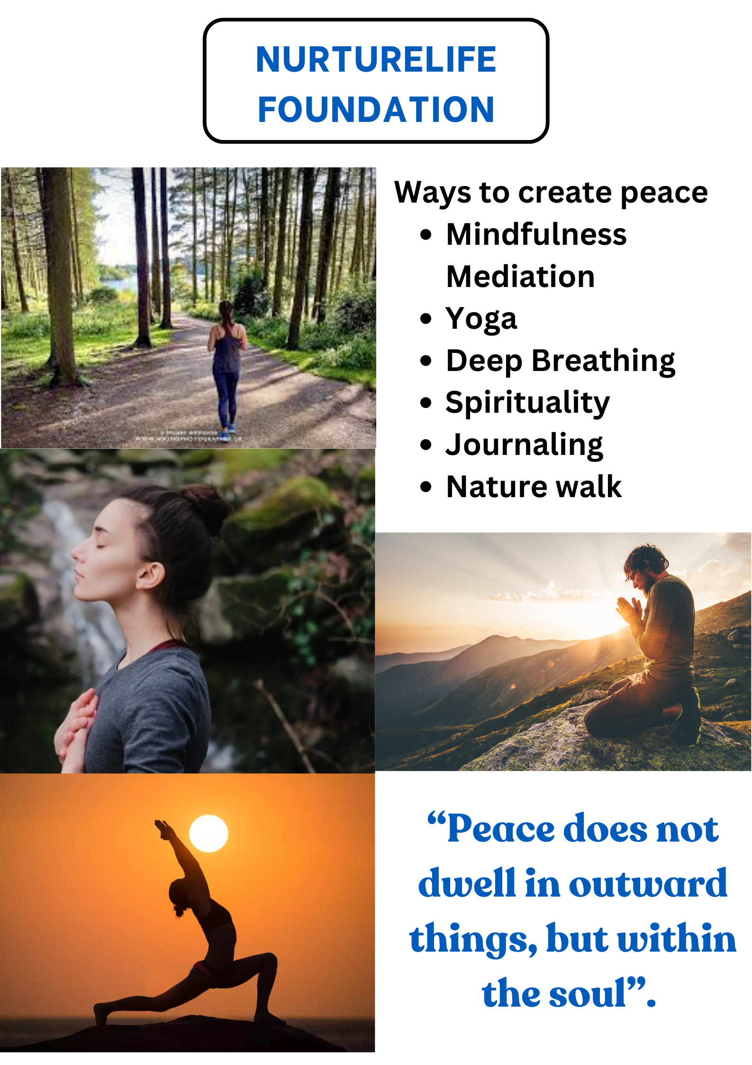
.

Slide 6

.
NURTURELIFE FOUNDATION
Peace
Begins with you
#StrongerTogether

Slide 7
What do you think and feel about what happened?
The response was positive, and we believe that our message resonated with those who saw the poster. It was gratifying to remind everyone about the significance of peace and how crucial it is to maintain it in our lives.

Slide 8
What would/could you do differently next time?
In our future efforts, we are considering a more personal approach. We may engage with people face-to-face, perhaps through activities like art therapy or simply by striking up conversations with strangers, learning about their days, and capturing moments through photographs.

Slide 9
What are you taking away from the experience?
This experience has left us with a profound sense of satisfaction and immense joy. Knowing that we contributed positively to promoting peace among our friends and family is truly rewarding.

Slide 10
What can you/we do, in the future, to further your project, to share more/better with people?
Looking ahead, we aspire to expand our project by incorporating charitable initiatives and organizing inclusive events like workshops and stress-relief activities. By making these resources available to a wider audience, we hope to continue spreading the message of peace and mental well-being.

Slide 11

Better world
Thank you

