Slide 1



HAPPINESS
By - #Sunshinesoul
Aditi Chopra & Madhvendra Singh

Slide 2
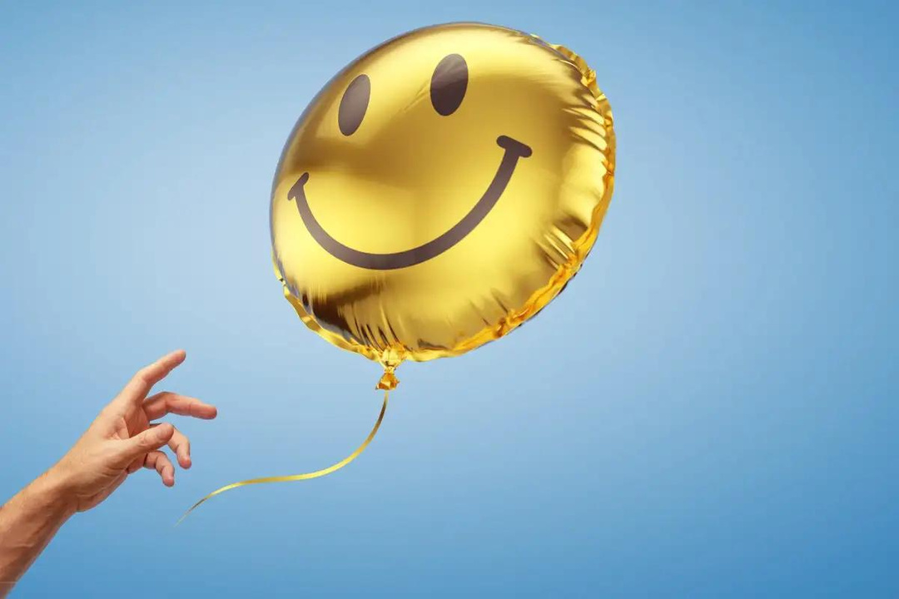
Joy, pleasure, contentment, and a sense of completion are some of the qualities that describe happy as an emotional state.
It is frequently said to involve joyful feelings and a sense of fulfilment in one's life.
Since the term "happiness" has such a broad definition, psychologists and other social scientists prefer to refer to this emotional state as "subjective well-being." Subjective well-being, as the name implies, primarily focuses on how a person feels about their current situation in life.
The Greek philosopher Aristotle offered another definition of happiness, claiming that it is the only human want and that all other human desires are means to achieving it. He held that there were four types of happiness: happiness that came from immediate gratification, happiness that came from comparison and success, happiness that came from doing good deeds, and happiness that came from finding fullness.
WHAT IS
HAPPINESS?

Slide 3


SOME KEY SIGNS OF HAPPINESS INCLUDE
Feeling like you are living the life you wanted
Going with the flow and a willingness to take life as it comes
Feeling that the conditions of your life are good
Enjoying positive, healthy relationships with other people
Feeling that you have accomplished (or will accomplish) what you want in life
Feeling satisfied with your life.

Slide 4
SOME TYPES OF HAPPINESS
Joy: A often relatively brief feeling that is felt in the present moment
Excitement: A happy feeling that involves looking forward to something with positive anticipation
Gratitude: A positive emotion that involves being thankful and appreciative
Pride: A feeling of satisfaction in something that you have accomplished
Optimism: This is a way of looking at life with a positive, upbeat outlook
Contentment: This type of happiness involves a sense of satisfaction

Slide 5

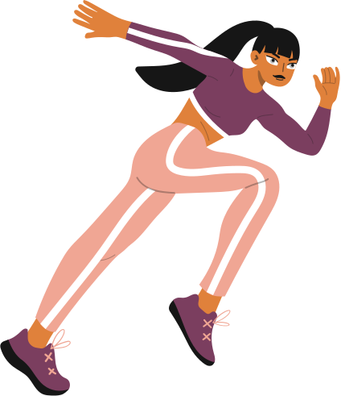


WHAT
CAN
WE DO
TO BE HAPPY?

Slide 6

WHAT IS HAPPINESS ACCORDING TO YOU?

Slide 7


THINGS YOU HAVE DONE TO SPREAD HAPPINESS AROUND YOU

Slide 8
THANKS
FOR
LISTENING!! :)

