Slide 1
EQRocks! How EQ is changing (maybe saving) the world, from the inside out!
by Matt Perelstein, an EQ Dude

Slide 2
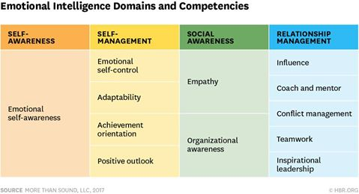
4 Components of EQ –
Inner vs. Outer focused

Slide 3
3 Main Areas of EQ
Our Thoughts
Our Feelings
Our Actions, and Behaviours
Head - Heart - Hand

Slide 4
EQ is the basis of us!
Every decision we make -- everything we do, everything we say, everything we write, and everything we are – are based on BOTH our thoughts and our feelings.
The key it to balance our thoughts and feelings to make the very best decisions we can!
IQ + EQ = ☺ !!

Slide 5
Did you know?!?
There's a Yale Center for Emotional Intelligence?
and one at Harvard Medical School.
UC Berkeley
Oxford
One of the largest, called Positive Psychology, is at U of Penn
… and the very best in the nation: UVA !!!

Slide 6
Did you know?!?
Google, Apple, Intel and others don’t hire based on IQ, anymore… but on EQ
They want to know if you can work on a team, if you can communicate, if you can learn, if you push yourself, if you're optimistic, if you're a self-centered, butt-head, etc.

Slide 7
Did you know?!?
Many of the world's biggest social problems today are significantly impacted by people (mostly guys) NOT knowing how to deal with their Thoughts, Feelings and Emotions?
Addictions, abuse, violence, divorce, suicide, abandonment, most crime, most mental health, a whole lotta physical health... even war…
are based on people NOT being able to successfully manage their Ts, Fs and Es!

Slide 8
4 Steps to Learning
1. Unconsciously Incompetent
“We don’t know that we don’t know.”
Clueless, unaware, no idea
2. Consciously Incompetent
“We find out that we don’t know.”
Oh, I see. Makes sense. Can't do it, but I see how it works.
3. Consciously Competent
“We learn how to do it different.”
Practice. Do. Think. Feel. Learn. Try. Experience. Grow. Fly. On Purpose.
4. Unconsciously Competent
“We do it different, without having to think about it (much).”
Soar. Sail. Drift. Enjoy! Connect. Be. Do. Have.
Smile!

Slide 9
Processing Feelings!
Let them Be
Let them speak
Listen to them
Let them reveal what's behind them
thought/belief/other feelings
Let them diminish
rightness ('wrong' about belief), story, thoughts
Let them go
sometimes requires anger
Let there be space
Let the space fill with positives
Let yourself smile!

Slide 10
3 Steps to High EQ
Awareness – Acceptance – Action (or NOT!)
1. AWARENESS - we have 2 sides to our brain, left and right, logic and feelings, and every decision we make is based on both our thoughts AND our feelings, our left-brain AND our right-brain. "We cannot make logical decisions on things we are not aware of." ~ Doc Downing
2. ACCEPTANCE - accept that we have thoughts AND feelings that must be balanced, that our feelings matter (a LOT!), and that we have total power and control over our own thoughts and feelings (emotional responsibility). No one MAKES us feel anything, emotionally... we make OURselves feel what we feel.
3. ACTION - Once we can BALANCE our head and our heart... our left and our right... our thoughts and our feelings... our yin and our yang... we can take more intentional, more effective and more loving Actions (or NOT!)

Slide 11
GREAT NEWS!
No one has EVER made you angry!
No one has EVER hurt your feelings
No one has EVER caused you pain, disappointment or anxiety.
Not without your permission, that is!
People can make us feel something physically…
but no one can MAKE us feel ANYTHING, emotionally, without our permission!

Slide 12
My wife Paula asked, "what's your #1 main point of this talk? What do you MOST want to get across to people?"
I said, that's easy... it's:
“Emotional Responsibility!”
Every one of my Thoughts, every one of my Feelings, and especially every one of my Behaviours are MINE!
I created them, I imagined them, I manufactured them… and I can change them… whenever I wish.

Slide 13
Emotional Responsibility (ER)
No one can make me think, or feel, or do anything I don’t really want to think, feel or do… ever!
I am “at choice”, every second, of every hour, all day, everyday.
THAT’s how we Take Control of our Feelings and Emotions… first we OWN them!

Slide 14
Left-Brain vs. Right-Brain
Left-brain Cognitive (IQ - Mind)
Right-brain Emotional (EQ - Heart)
Whole Body - movements, actions, words, deeds.
IQ + EQ + Body = ☺

Slide 15
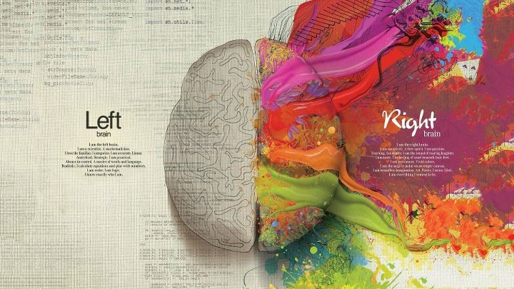
Left-brain vs. Right-brain

Slide 16
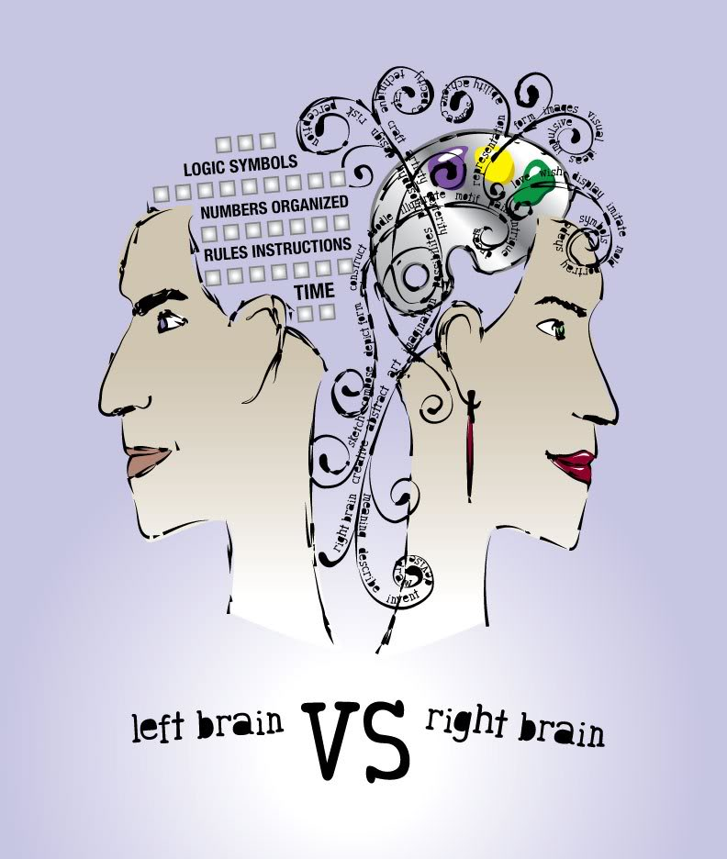
Left-brain vs. Right-brain

Slide 17
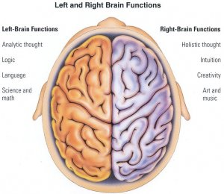
Left-brain vs. Right-brain

Slide 18
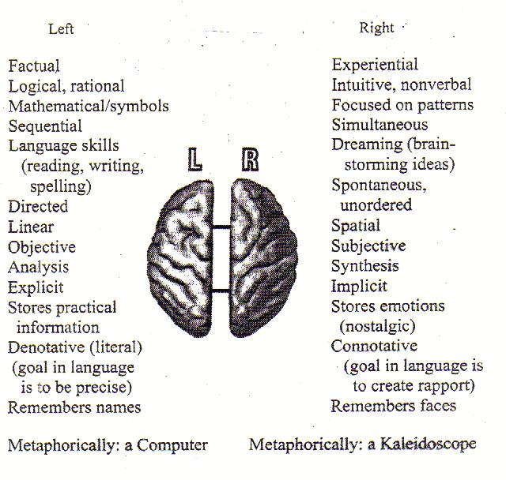
Left-brain vs. Right-brain

Slide 19
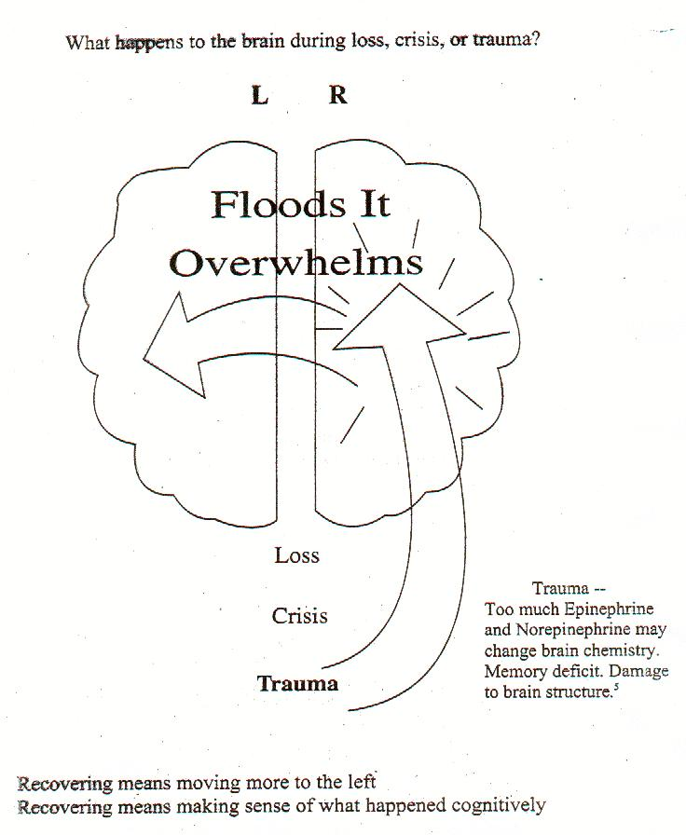
Left-brain vs. Right-brain

Slide 20
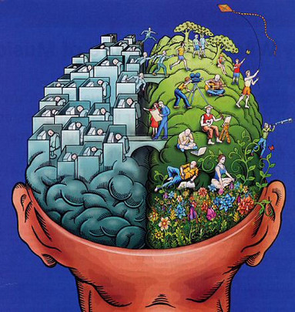
Left-brain vs. Right-brain

Slide 21
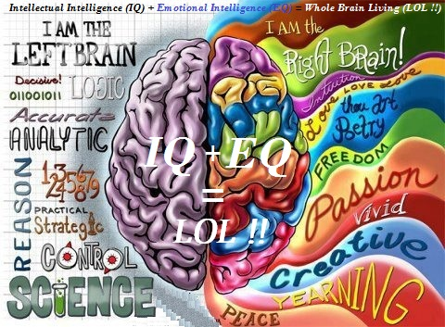
Left-brain vs. Right-brain

Slide 22
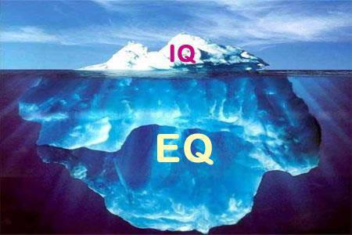
Left-brain vs. Right-brain

Slide 23

3 Points to EQ (video)

Slide 24
2. EQRocks!
EQ Premises
EQ Distinctions
EQ Resources
EQ Quotes

Slide 25
EQRocks Premises
"No one can make us feel anything emotionally, without our permission."
We choose our actions, (pretty much) every single one!
Happiness is a Choice. Happiness is OUR choice, every second of every day, for the rest of our lives.
Feelings Matter, a LOT!
"Feelings expressed, as intensely as they are felt, will REDUCE in intensity, and are FREE to Change!" ~ Doc Downing, PhD

Slide 26
EQRocks Premises (cont’d)
"Feelings aren't good or bad... they just are." ~ Doc Downing PhD
"Feelings are a good thing, not a bad thing."
~ me
"In fact, our thoughts and feelings are THE thing, when it comes to happiness, sanity and success in life!"
~ me again

Slide 27
EQRocks Premises (cont’d)
- No matter what is happening outside of you (and even some things that are happening INSIDE of you), you STILL have control your thoughts, feelings and especially your behaviours
EMOTIONAL MASTERY: If you can handle your own fear, anger & sadness, there just ain't much that life can throw at you that you cannot handle!

Slide 28
EQ Distinctions
Thoughts and Feelings
EQ and IQ
Feelings and Emotions
Positive and Negative Emotions
Guilt and Shame
Venting and Whining
Surviving and Thriving
Victim and Victor
My problems and NOT my problems

Slide 29
EQ Quotes
Pictures of our original EQ Quotes
http://bit.ly/EQQuotes (case sensitive)

Slide 30
3 Levels of YOU
u, U and UU
Big U = You, now
little u = You, then... actually, any time in the past.
Universal UU = Higher you, the wise and wonderful you

Slide 31
3 Steps to Dealing with Feelings
KNOW what I feel when I feel it.
ACCEPT what I feel when I feel it
EXPRESS my feelings (or NOT) in acceptable ways without put-downs, name calling, judgments, sarcasm, controlling, demanding, guilt trips

Slide 32
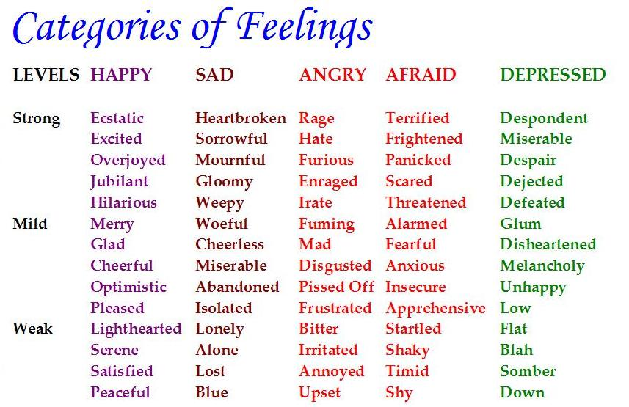
Feelings Chart

Slide 33
3 Steps to EQ
1. Get a Clue – we understand and appreciate how important our Feelings and Emotions are to our happiness and life success.
2. Get a Grip – we learn to KAE, Know - Accept - Express feelings to truly take control of ourselves and our lives.
3. Get a Life – we continue to learn, practice, connect and grow, making the EQ concepts an integral part of our thoughts, relationships and daily lives!

Slide 34
The 7 Steps to Healing Feelings
(pronounced “I Care”)
Identify
Connect
Accept
Express
Release
Replace
REJOICE!!

Slide 35
8 Steps to Process My Negative Feelings
1. “I”: I know me, and I am aware of myself and my heart, and I am mindful of my feelings without judging them.
2. Know: I can identify, separate and name my feeling(s). I know my sadness, my anger and my fear.
3. Accept: I accept and am Ok with whatever I’m feeling. No more denial, avoidance or lying about my feelings.
4. Express: I can express my feelings, fully and completely, but in acceptable ways, without blowing up, stuffing them, or hurting anybody or anything (including myself).
5. Edit: I become aware of my negative thoughts, and change them to more positives
6. Release: Once felt, I can let go of my negative feelings, and let them flow out of my body.
7. Replace: I can fill the space left by the negative feelings with peace, joy and love.
8. REJOICE!: I encourage and respect my feelings (negative or positive), I understand my feelings, allow them, manage them, learn from them and celebrate myself and my life!
Woo-Flippin’-Hoo! ☺ ☺
I Know Accept Express Edit Release Replace Rejoice
IKAEERRR – pronounced “I Care!”

Slide 36
3 Modes of EQ
Past
Present
Future
We deal with the unresolved negative thoughts and feelings from our past, to live fully, and completely in the present, in order to make our future look, and more importantly feel, as great as we can -- together!

Slide 37
#1 Most Communication Skill
Live with SOUL
Shut-up, Open-Up… and Listen!

Slide 38
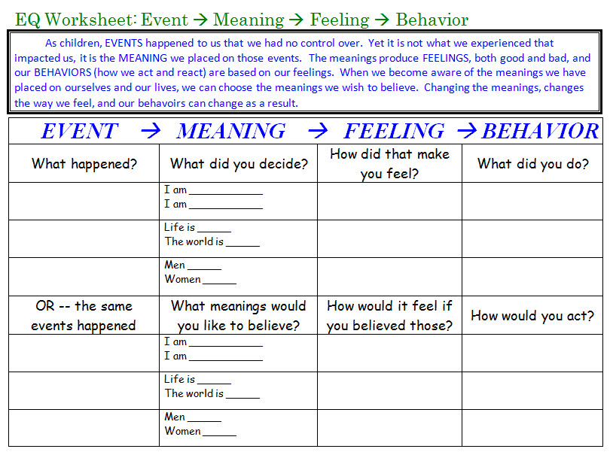
EMFB Worksheet (blank)

Slide 39
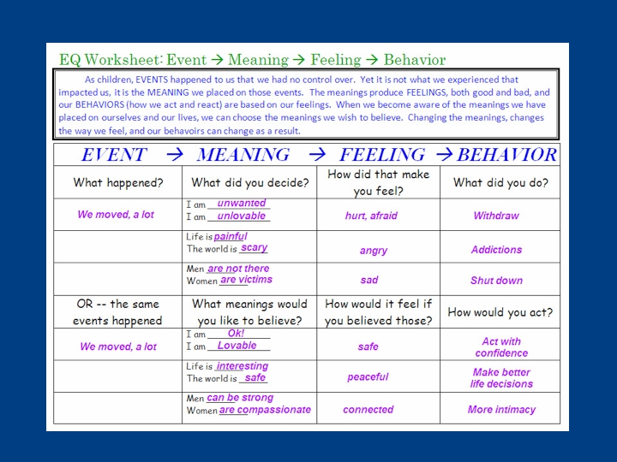
EMFB Worksheet (example)

Slide 40
Purposes of the ND Workshop
Help us recognize how our present life is still being influenced by our past.
Allow us to understand and release feelings and beliefs from the past that we’d like to put behind us.
Enable us to take full responsibility for how we choose to live our life, from this day forward.

Slide 41
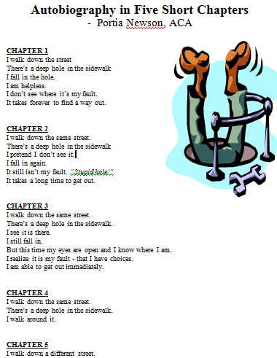

Slide 42
EQ Questions To Ask Yourself
Who or what Hurt you the most?
Who or what are you Afraid of?
Who or what are you Angry at?
What have you Decided about Life as a result of your pain?
What is keeping you from releasing your pain?
How would your life be different if you were to release the pain & forgive?
What I want to Re-decide about Life is: __

Slide 43
Feelings, 1-by-1:
It’s great to have large feeling vocabulary, to accurately describe what you feel. Yet, in EQ Healing, we’ve found it helpful to “boil down” our feelings into just a simple few:
3 Main Negative Feelings:
  Fear
  Sadness
  Anger
3 Main Positive Feelings:
  Peace
  Joy
  Love (the key to it all!)

Slide 44
Forgiveness
Forgiveness is for you!
It has very little to do with ‘them’.
Forgiveness is about removing the pain, anger and hurt from YOU around what they did.
Acceptance does not mean Approval!

Slide 45
5. My Preachings (Now What?!?)
EQ4Peace
Each1Teach1EQ
I want 3 things from/for you.
  1. Accept ER (even X-ER, if you're up for it!)
  2. Learn and practice EQ
  3. Share EQ with at least 1 other person
Join us in our noble goal: #1B_EQers_By_2039

Slide 46
EQ4Peace
4 Realms of #EQ4Peace
Inner Peace
#EQ4InnerPeace
Peace between Individuals
#EQ4InterpersonalPeace
Peace in Society
#EQ4SocialPeace
World Peace!
#EQ4WorldPeace

Slide 47
5. My Preachings (Now What?!?)
So, I believe we need:
EQ Membership site, a "Family" of EQers, where you can belong with others on the same path to growth and prosperity.
An EQ Database of all things EQ -- there is an AMAZING # of things happening in the world, EQ-wise... but there is no one place to find it all.
An EQ University -- a world-wide network of on-line, by-phone and in-person EQ training opportunities (which we could provide as an affiliate)
An EQ Community -- not just chatting, but people ACTUALLY helping others with their feelings and emotions. Trained volunteers will provide free help, but if you want more indepth, we'll have pros, coaches, therapists, etc to help for a fee. Big need. Online therapy is booming, and most everyone needs to have someone safe to talk to now and then.
EQ Industry Leadership / oversite

Slide 48
Explaining EQ
EQRocks video script (thru slide 18)
https://docs.google.com/presentation/d/1XdUiE_HYFRHb_BsjIegnwEBTGuQXpQvRS6_coOBQV1U/edit#slide=id.g1d2430f313_3_51

Slide 49
Teaching EQ (SEL) in Schools
SEL 5-year Meta-study of K-12 School Districts that have adopted SEL
http://onlinelibrary.wiley.com/doi/10.1111/j.1467-8624.2010.01564.x/references
This article presents findings from a meta-analysis of 213 school-based, universal social and emotional learning (SEL) programs involving 270,034 kindergarten through high school students. Compared to controls, SEL participants demonstrated significantly improved social and emotional skills, attitudes, behavior, and academic performance that reflected an 11-percentile-point gain in achievement.

Slide 50
EQ in Medicine, the ACE Study
Adverse Childhood Experiences (ACE)
Bridging the gap between childhood trauma and negative consequences later in life.
http://acestudy.org/
Calculate your ACE score:
http://acestudy.org/files/ACE_Score_Calculator.pdf
The Study makes it clear that time does not heal some of the adverse experiences we found so common in the childhoods of a large population of middle-aged, middle class Americans. One does not ‘just get over’ some things, not even fifty years later.
http://acestudy.org/files/Gold_into_Lead-_Germany1-02_c_Graphs.pdf
Relationship of Childhood Abuse and Household Dysfunction to Many of the Leading Causes of Death in Adults: The Adverse Childhood Experiences (ACE) Study
http://www.ajpm-online.net/article/PIIS0749379798000178/abstract

Slide 51
ACE Study 2
Growing up experiencing any of the following conditions in the household prior to age 18:
Recurrent physical abuse
Recurrent emotional abuse
Contact sexual abuse
An alcohol and/or drug abuser in the household
An incarcerated household member
Someone who is chronically depressed, mentally ill, institutionalized, or suicidal
Mother is treated violently
One or no parents
Emotional or physical neglect

Slide 52
Social Media
@MattPerelstein on Facebook & LinkedIn
The Emotional Intelligence Networks – 6 Seconds
  LinkedIn: 100,000 Business EQers!
  http://www.linkedin.com/groups?gid=75300
  Facebook: 20,000 members
  https://www.facebook.com/groups/SixSecondsEIN
Emotional Intelligence Applications
  Best EQ resource I know of, search by topic
  https://www.facebook.com/groups/EQApplications
  Facebook hashtag: #EQRocks
  https://www.facebook.com/hashtag/EQRocks

Slide 53
Contact Us
Workshop: www.NewDirectionsWorkshop.com
Change the World with EQ: www.EQRocks.com
Free EQ Stuff: bit.ly/FreeEQStuff
Me: www.MattPerelstein.com
Email: Matt@2GetHelp.com
Phone: (916) 599-8597

Slide 54
Prize: Free Ebook
“Taking Control of Your Life” eBook,
by Myron “Doc” Downing, Ph.D., LMFT
http://bit.ly/EQBook
https://www.smashwords.com/books/view/360432

Slide 55
Big Goal: 1B EQers by 2039
Each 1, Teach 1 EQ! http://bit.ly/Each1Teach1EQ
Introduce at least 1 other person, any person, to EQ, sometime in your lifetime

Slide 56
Big Goal: 1B EQers by 2039 (2)
Each 1, Teach 1 EQ! http://bit.ly/Each1Teach1EQ
If we learn just for us… that’s cool
But, if we learn SO THAT we can teach, and pass on what we’ve learned, it gives a whole different energy and perspective to it.
Besides, that’s what EQ is all about…
reaching out, helping people, connecting
… and LOVE!

