Slide 1
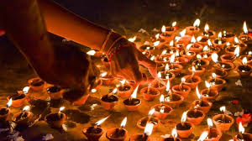
Busy Bee Consultancy Services OMG – 2020
Facilitator
Sangeetha Ramesh, MA (IO - Psy), MBA (HR).,
Edupreneur / Educationalist
Trainer / Coach / Consultant
Madurai – 14.

Slide 2
Brain Storming
Count the no of ‘F’ in the sentence below.
FINISHED FILES ARE THE RESULTS OF YEARS OF SCIENTIFIC STUDY COMBINES WITH THE EXPERIENCE OF YEARS.
Limit 15 seconds.

Slide 3
Answers:
A) 3; B) 4; C) neither; D) more
Exact no’s! - 6
Our vision tends to skip the word ‘of’ or perceive it as ‘versus’
One’s perception may not always be correct.

Slide 4
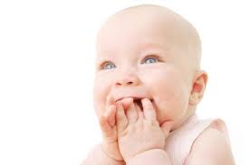
Do you feel OMG?
Oh
My
Gosh

Slide 5
OMG Session – Take (A)ways
4 F’s – Sacrifice ( now )
2 F’s – Receive ( then )
8 C’s – Credits ( later )
Successful Growth

Slide 6
Sacrificing: NOW
offering of food, objects to others
the lives of animals or humans to a higher purpose, as an act of worship.
give up (something valued) for the sake of other considerations.

Slide 7
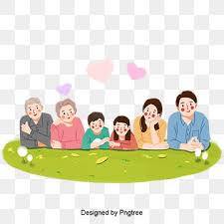
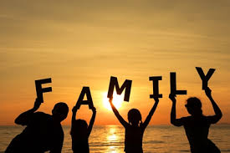
1. Family

Slide 8
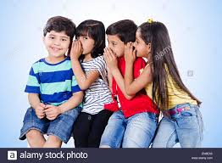
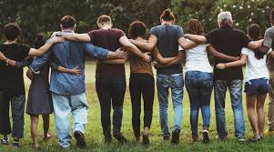
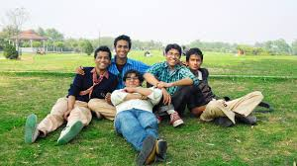
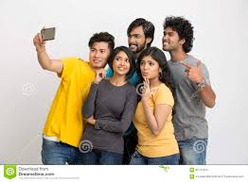
2. Friends

Slide 9
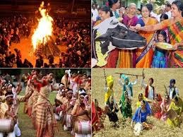
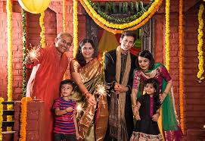
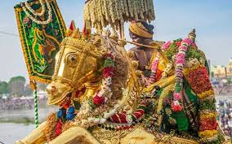
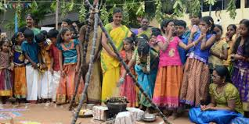
3. Festivals

Slide 10
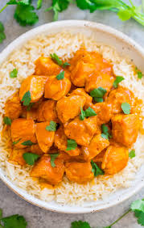
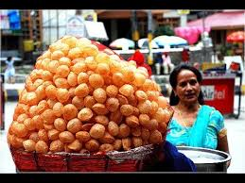
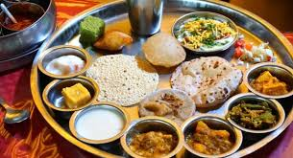
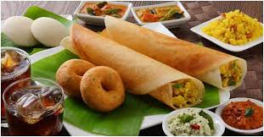
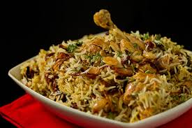
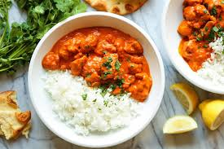
4. Favorite Food:

Slide 11
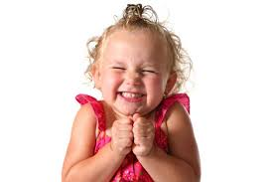
Receive: Then
be given, presented with, or paid (something).
form (an idea or impression) as a result of perception or experience.

Slide 12
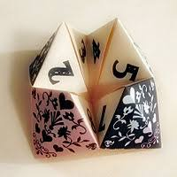
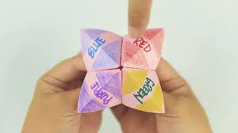
1. Fortune
chance; luck.
the success or failure of a person or enterprise over a period of time.
How many play this?

Slide 13
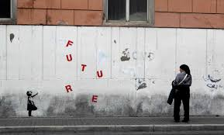
2. Future
events that will or are likely to happen in time to come.
a prospect of success or happiness.
Are you ready to check our fortune and future?

Slide 14
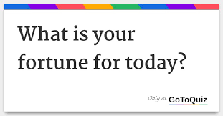
Four cups – Fortune teller

Slide 15

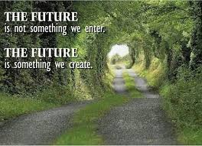
How do you see your future?

Slide 16
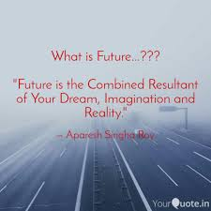

Do you feel OMG! – Oh My God

Slide 17
III. Credits – (Later)
Acknowledgement or praise you receive when an action or idea become apparent.
Being accountable for the act of job you are engaged with.
Receive biggest benefit of credit is saving money.

Slide 18
How do you earn credits?
an occupation or profession.
Career is what you do for a living and how you advance through a profession or company.
The progress and actions taken by a person throughout a lifetime.
A career goal is that an individual intends to pursue throughout his career to come up with effective action plans.
an occupation undertaken for a significant period of a person's life and with opportunities for progress.

Slide 19
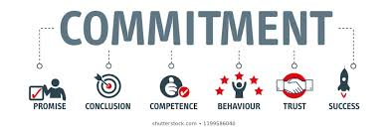
1. Commitment:
Meaning:
The state or quality of being dedicated to a cause, activity, etc.
Benefits:
Committed people have a good self-concept, strong self-esteem, and a balance between what they want with what they're capable of.

Slide 20

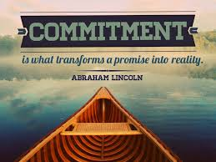
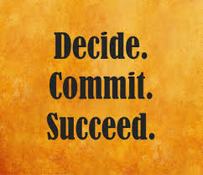
Virtually:

Slide 21
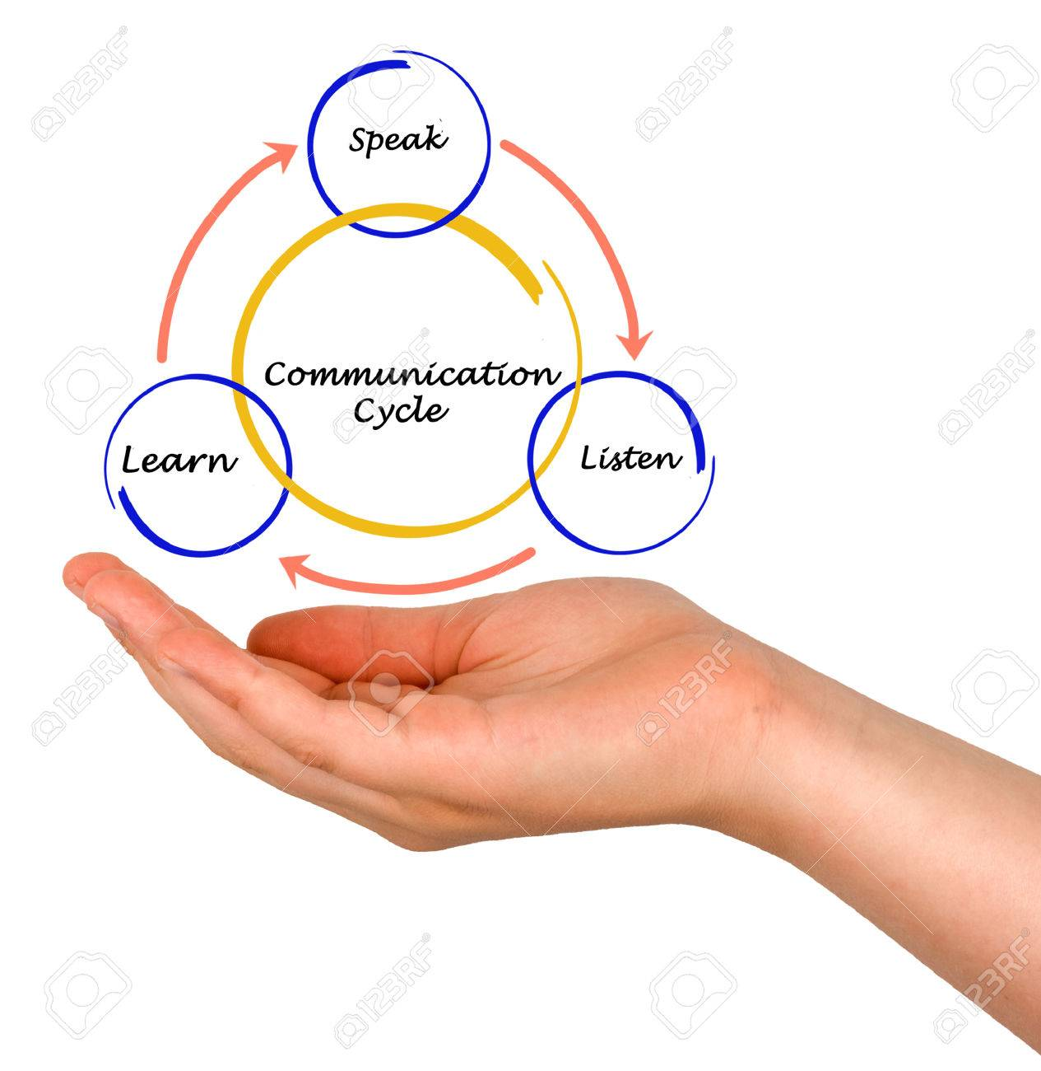
2. Communication
Communication is simply the act of transferring information from one place, person or group to another.

Slide 22
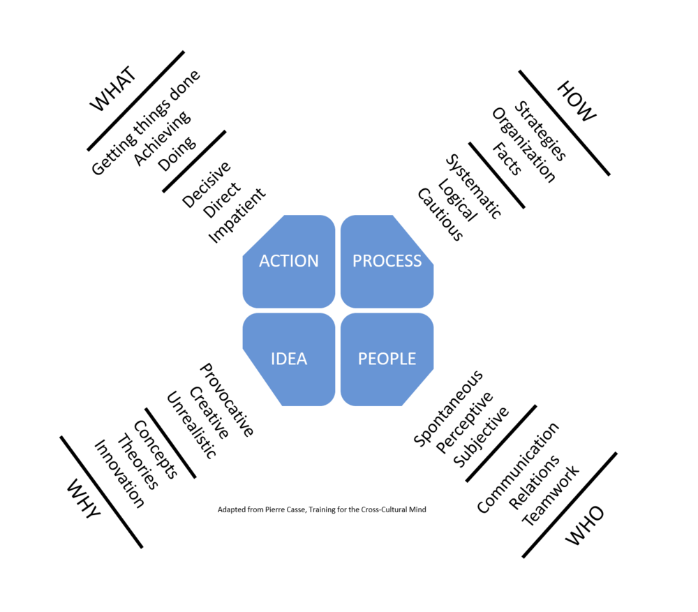


Communication forwards

Slide 23
3. Confidence:
Confidence comes from
feelings of well-being,
acceptance of your body and mind (your self-esteem) and
belief in your own ability, skills and experience.
Truly confident people realize to know a lot, and know the only way to learn more is to listen more.

Slide 24

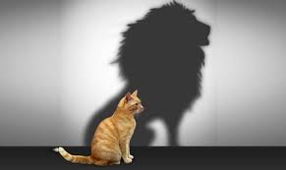
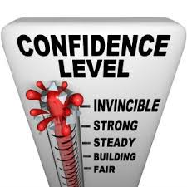
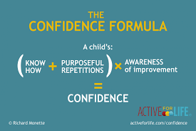
How do you build Confidence?
Have a little confident in what you do initially, you can do a bigger thing well too.

Slide 25
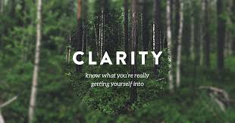
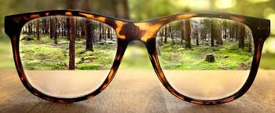

4. Clarity :
Clear Vision / Eye Sight
the quality of being certain or definite.
the quality of being easy to see or hear; sharpness of image or sound.
"the clarity of the picture"

Slide 26
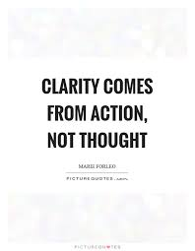
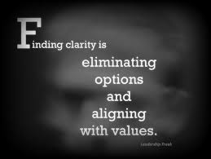
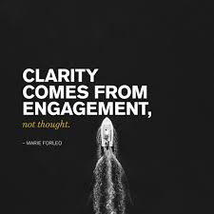
How does clarity been noticed?

Slide 27

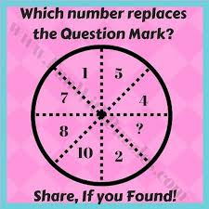
Ice Breaking:
Oh
My
Goodness!

Slide 28
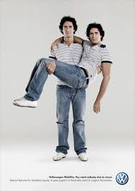
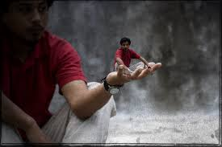
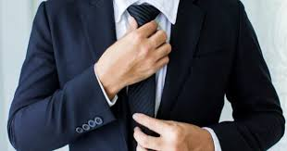
5. Carrying Yourself:
To behave, especially with respect to how one's speech, body language, facial expressions, and grooming convey one's opinion concerning oneself.
Emphasizing the manners

Slide 29



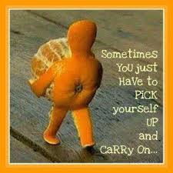
6. Continuing:
without a break in continuity; ongoing

Slide 30

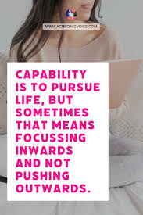

7. Capability
the extend of someone’s or something’s ability
Power of doing something.

Slide 31

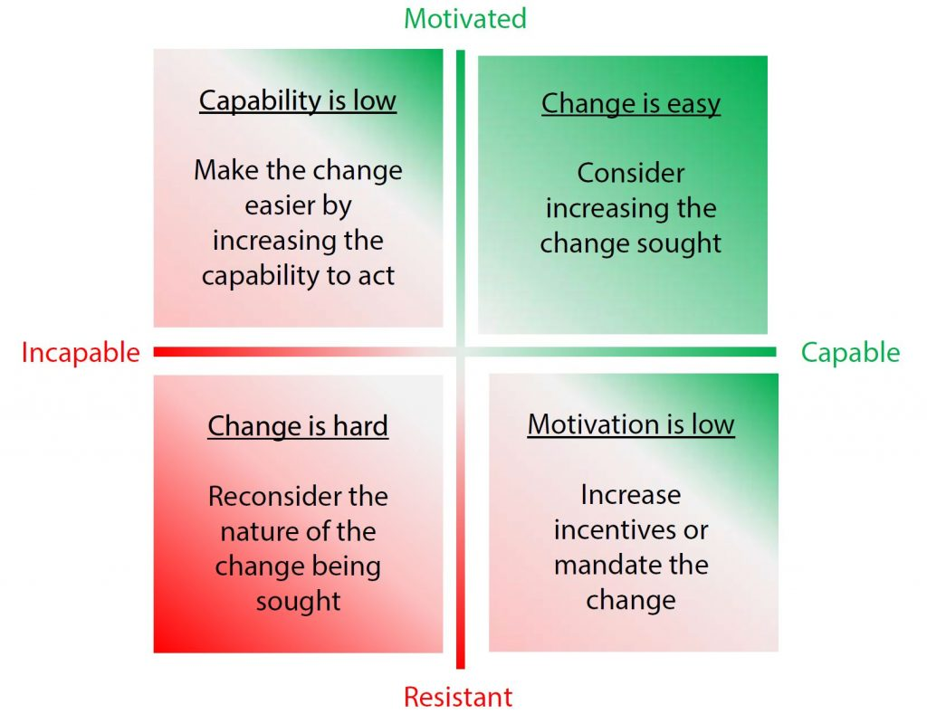

Slide 32
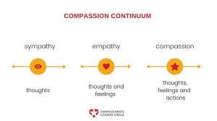
8. Compassionate
Sympathetic consciousness of others.
you feel deeply for other person and forward your assistance, even before they ask for it.

Slide 33

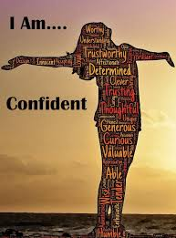
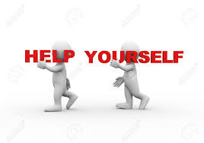
NOW / THEN / LATER

Slide 34
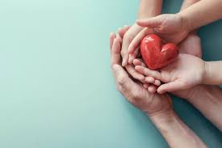
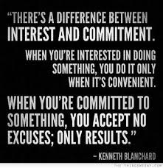

BBC – Associate your greatness

Slide 35


Thanks to all participants!
Ur time; Ur respect; Ur encouragement and support;
Would recommend an audio / video feed forwards for future progression.
Forward your comments to my what’s app / email inbox.
8300-954-729
bbcservicesmdu@gmail.com

